Slide 1










Open Enrollment 2025
January 2025 – December 2025

Slide 2







Welcome to your 2025 Benefits!
Contents
California Institute of Integral Studies continues to offer eligible employees a comprehensive benefit plan.
Benefits Overview | 3
Medical Plans | 5-6
Dental Plan | 7
Vision Plan | 8
Life/AD&D | Income Protection | 9-10
Employee Assistance Program | 11
FSA and Commuter | 12
Education Assistance Program | 13
Fitness SF | 14
When Benefits Begin | 15
How to find a provider | 16
Contacts | 18
!
What changed for 2025?
Medical Coverage
No Change
Dental Coverage
No change
Vision Coverage
No change
How to Enroll
Read your materials | Login to your online benefit portal through Paychex
Verify your dependents | Choose your plans & benefits
Note: The following descriptions of available benefit election options are purely informational and have been provided to you for illustrative purposes only. Payment of benefits will vary from claim to claim within a particular benefit option and will be paid at the sole discretion of the applicable insurance provider for each benefit option. The terms and conditions of each applicable policy or certificate of coverage will provide specific details and will govern in all matters relating to each particular benefit option described in this summary. In no case will any information in this summary amend, modify, expand, enhance, improve or otherwise change any term, condition or element of the policies or certificates of coverage that govern the benefit options described in this summary.
Notes:
Discuss that CIIS is using Paychex and that the benefit of bringing payroll, benefit admin and, COBRA under one house has enormous benefits in providing consistency. CIIS administration has had some legitimate system issues in previous year’s that we hope are put to bed and have appreciated all of the employee’s patience. The link for the system will be or has been provided by HR.
Using a new system has some natural issues so we ask everyone to pay close attention to their information. Names, socials, dates of birth, addresses, everything.

Slide 3





Benefits Overview In-Network Benefits
Open Enrollment begins December 11th and ends December 25th
Medical | Kaiser DHMO | MERP Included with Kaiser | Roundstone Captive
Annual Deductible | $3,000 | $6,000 | $250/$500 | $250/$500
Annual OOP Max | $6,000 | $12,000 | $4,000 | $8,000 | $4,000 | $8,000
Coinsurance | 30% | 10% | 20%
Office Visit (PCP | SPC) | $40 | $40 Copay / Visit | $20 | $ 20 Copay / Visit | $20 | $20 Copay / Visit
Dental | Guardian PPO Plan | Annual Deductible: $50 Ind | $150 Fam Annual Max: $2,000 Per Person Coinsurance: Preventive: No Charge | Basic: 10% | Major: 40% Adult and Child Orthodontia: 50%, up to $2,000
Vision | VSP via Guardian Exam | Materials | $10 | $25 Up to $60 for contact lenses evaluation and fitting
 | Service Frequency | Exam – Once Every Calendar Year Lenses – Once Every Calendar Year Frames – Once Every Two Calendar Years
Life & Disability | Lincoln Financial Group Life | 1x your salary up to $350,000
 | Lincoln Financial Group Disability | STD: 25% of salary up to $1,154 a week STD: 60% of salary up to $1,154 a week LTD: 60% of salary up to $6,000 a month
Note: The benefit plan information shown in this guide is illustrative only. To the extent the benefit plan information summarized herein differs from the underlying plan details specified in the insurance documents that govern the terms and conditions of the plans of insurance described in this guide, the underlying insurance documents will govern in all cases.

Slide 4
Medical Plan Eligibility
Full Time Employees
Employees working 30+ Hours per week Eligible Dependents include: Spouses/Domestic Partners – If Spouses and Domestic Partners have access to coverage elsewhere and still join the CIIS plan, a spousal surcharge applies Dependent Children
Part Time Employees
Employees working 20+ Hours per week Eligible Dependents include: Spouses/Domestic Partners – If Spouses and Domestic Partners have access to coverage elsewhere and still join the CIIS plan, a spousal surcharge applies Dependent Children
Spousal Surcharge
For those enrolling as: Employee + Spouse or Family Workers need to sign an acknowledgment saying that their spouse or partner doesn’t have any other group insurance. If you have another insurance but decide not to use it, you can still get insurance from CIIS. But, if your spouse or partner has insurance from somewhere else, you’ll have to pay extra. This could be insurance from: a. Their own job b. Medicare c. Medicaid d. Veterans Administration e. Any other group insurance If this is the case, CIIS will take an extra $250 from your paycheck every pay period, on top of what you already pay for your insurance.

Slide 5


In-Network preventive care is covered at
no charge!
MEDICAL
KAISER PERMANENTE | Deductible HMO Plan | With MERP Plan Employee Pays
The following table is an overview of in-network covered services. Out-of-network services are available for Emergency services only. For full plan details, refer to the Summary of Benefits and Coverage. After Deductible: Annual deductible must be met before copay and coinsurance applies. Deductible Waived: Annual deductible does not apply.
Plan Network Policy Number | Kaiser 8804 | Kaiser 8804
Annual Deductible | $3,000 Individual $6,000 Family | $250 Individual $500 Family
Coinsurance | 30% | 10%
Annual Out-of-Pocket Max | $6,000 Individual $12,000 Family | $4,000 Individual $8,000 Family
Office Visit Primary Care | $40 | $20
Office Visit Specialty | $40 | $20
Outpatient Mental Health | $40 | $20
Lab | X-Ray | $10/Encounter after deductible | 20% after deductible
Advanced Imaging | 30% up to $50/Procedure after deductible | 20% after deductible
Emergency Room | 30% after deductible coinsurance waived if admitted | $100 Copay + 20% after deductible
Inpatient Hospital | 30% after deductible | 20% after deductible
Outpatient Surgery | 30% after deductible | 20% after deductible
Urgent Care | $40 | $20
Chiropractic | $10 Limited to 30 visits per year combined with acupuncture | $10
Acupuncture | $10 Limited to 30 visits per year combined with chiro | $10
Prescription Drugs: Retail (Up To 30-days) | Mail Order (Up To 100-days)
Rx Deductible | None |  | None
 | Retail | Mail Order | Retail | Mail Order
Generic | $10 | $20 | $10 | $20
Brand-Name | $30 | $60 | $30 | $60
Non-Preferred Brand | $30 | $60 | $30 | $60
Specialty | 20% up to $150 (30-Day Retail) |  | 20% up to $150 (30-Day Retail)

Slide 6
In-Network preventive care is covered at
no charge!
MEDICAL
ROUNDSTONE CAPTIVE | Bywater EPO Plan
▪ The following table is an overview of in-network covered services. There are NO OUT OF NETWORK SERVICES except for a bona-fide Emergency. For full plan details, refer to the Summary of Benefits and Coverage. After Deductible: Annual deductible must be met before copay and coinsurance applies. Deductible Waived: Annual deductible does not apply.
Plan Network Policy Number | Cigna PPO 22608
Annual Deductible | $250 Individual $500 Family
Coinsurance | N/A
Annual Out-of-Pocket Max | $4,000 Individual $8,000 Family
Office Visit Primary Care | $20
Office Visit Specialty | $20
Outpatient Mental Health | $20
Lab | X-Ray | 20% after deductible
Advanced Imaging | 20% after deductible
Emergency Room | $100 Copay + 20% after deductible
Inpatient Hospital | 20% after deductible
Outpatient Surgery | 20% after deductible
Urgent Care | $20
Chiropractic | $10 Limited to 30 visits per year combined with acupuncture
Acupuncture | $10 Limited to 30 visits per year combined with chiro
Prescription Drugs: Retail (Up To 30-days) | Mail Order (Up To 100-days)
Rx Deductible | None
 | Retail | Mail Order
Generic | $10 | $20
Brand-Name | $30 | $60
Non-Preferred Brand | $60 | $120
Specialty | 30% up to $500 (30-Day)
RxValet (voluntary participation) | $0
Notes:
IF a medication has a cost above a $500 threshold the member will be contacted by RxValet. This service is optional but if used the member would pay $0 for the medication.

Slide 7


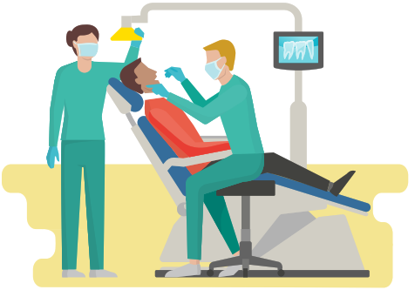


DENTAL
PREVENTIVE: (e. g. Cleanings, Fluoride Treatments, Oral Exams, Sealants and X-Rays.) | BASIC: (e. g. Anesthesia, Fillings, Periodontics, Root Canal, and Extractions.) | MAJOR: (e. g. Bridges, Dentures, Crowns, Dental Implants, Inlays, Onlays and Veneers.)
Guardian PPO Plan | In-Network Employee Pays | Out-of-Network Employee Pays
The following table is an overview of covered services. For full plan details, refer to the Summary of Benefits and Coverage. After Deductible: Annual deductible must be met before copay and coinsurance applies. Deductible Waived: Annual deductible does not apply.
Plan Network Policy Number | Dental Guard Preferred 556153
Calendar Year Deductible | $50 Individual | $150 Family | $50 Individual | $150 Family
Annual Benefit Max | $2,000 Per Person | $2,000 Per Person
Preventive | No Charge | No Charge
Basic | 10% after deductible | 20% after deductible
Major | 40% after deductible | 50% after deductible
Orthodontia (Adult and Child ) | 50% after deductible Lifetime Max: $2,000 | 50% after deductible Lifetime Max: $2,000
Maximum Rollover*
Rollover Threshold | $800
Rollover Amount | $400
Rollover In-network Amount | $600
Rollover Account Limit | $1,500
*You must have at least one service rendered during the year and use less than $700 of your annual maximum in order to qualify for the $500 carryover.
Download the Guardian app
to view ID card and find an
in-network provider!
Dental cleaning under preventive care is covered once every 6 months.
Note: The benefit plan information shown in this guide is illustrative only. To the extent the benefit plan information summarized herein differs from the underlying plan details specified in the insurance documents that govern the terms and conditions of the plans of insurance described in this guide, the underlying insurance documents will govern in all cases.

Slide 8





VISION
VSP via Guardian | In-Network
The following table is an overview of in-network covered services. Out-of-network services are also available. For full plan details, refer to the Summary of Benefits and Coverage.
Plan Network Policy number | VSP Network Signature Plan 556153
Exam | Materials Copay | $10 | $25
Service Frequencies
Routine Eye Exam | Once Every Calendar Year
Lenses (Pair) | Once Every Calendar Year
Contact Lenses Instead Of Glasses | Once Every Calendar Year Up to $130 allowance for contacts; Up to $60 for Evaluation and Fitting
Frame Benefits | Once Every Two Calendar Years Up to $130 allowance for a wide selection; $70 allowance for Costco
!
Benefits refresh based on service date, i.e. 12 months from last service date.
ADDITIONAL
IN-NETWORK DISCOUNTS
Guardian does not provide printed ID cards. Go to
www. guardiananytime.com to print a copy or verify your
information to your
provider.
20% Off
Remaining Frame Balance
Beyond Paid Coverage
Extra $20
To Use Towards
Select Frame Brands
Up To 15% Off
Laser Correction
Surgery
Note: The benefit plan information shown in this guide is illustrative only. To the extent the benefit plan information summarized herein differs from the underlying plan details specified in the insurance documents that govern the terms and conditions of the plans of insurance described in this guide, the underlying insurance documents will govern in all cases.

Slide 9
LIFE and AD&D Insurance
Basic Life And Accidental Death And Dismemberment (AD&D): Lincoln
Life Benefit: 1x Basic Annual Earnings, Up to $350,000 AD&D Benefit: Equal to the Life Benefit Benefit Reduction Schedule: 35% reduction at age 65, 50% at age 70, 65% at age 75. Benefit terminates upon retirement
Voluntary Life & Accidental Death And Dismemberment: Lincoln
Employee: Purchase up to lesser of $500,000 or 5x annual salary In $10,000 increments Guarantee issue: $150,000 Annual Step Ups Allowed in two increments | Spouse: Purchase up to $250,000 In $5,000 increments (no more than 100% of employee amount) Guarantee issue: $30,000 Annual Step Ups Allowed in two increments | Dependent child(ren): 6 months to age 26: $10,000 Age 1 day to 6 months: $250 Options: $2,500, $5,000, $7,500, and $10,000. Guarantee issue: N/A
Benefit reduction schedule: 35% reduction at age 65, 50% at age 70, 65% at age 75.
Don’t forget to update your beneficiary!
Health statement required for amounts over guarantee amount. For complete rates and details, please refer to the full plan summary.
Note: The benefit plan information shown in this guide is illustrative only. To the extent the benefit plan information summarized herein differs from the underlying plan details specified in the insurance documents that govern the terms and conditions of the plans of insurance described in this guide, the underlying insurance documents will govern in all cases.

Slide 10
INCOME PROTECTION
Short Term Disability (STD): Lincoln Financial Group – Statutory States
Weekly Benefit: 25% of your pre-disability earnings up to a max of $1,154 a week Benefit Waiting Period: 14 days Benefit Payout Period: 11 Weeks Voluntary Benefit
Short Term Disability (STD): Lincoln Financial Group – Non- Statutory States
Weekly Benefit: 60% of your pre-disability earnings up to a max of $1,154 a week Benefit Waiting Period: 14 days Benefit Payout Period: 11 Weeks Voluntary Benefit
Long Term Disability (LTD): Lincoln Financial Group
Monthly Benefit: 60% of your pre-disability earnings up to a max of $6,000 a month Benefit Waiting Period: 90 days Benefit Payout Period: Social Security Normal Retirement Age Employer Paid Benefit for all eligible employees
Health statement required for amounts over guarantee amount. For complete rates and details, please refer to the full plan summary.
Note: The benefit plan information shown in this guide is illustrative only. To the extent the benefit plan information summarized herein differs from the underlying plan details specified in the insurance documents that govern the terms and conditions of the plans of insurance described in this guide, the underlying insurance documents will govern in all cases.

Slide 11
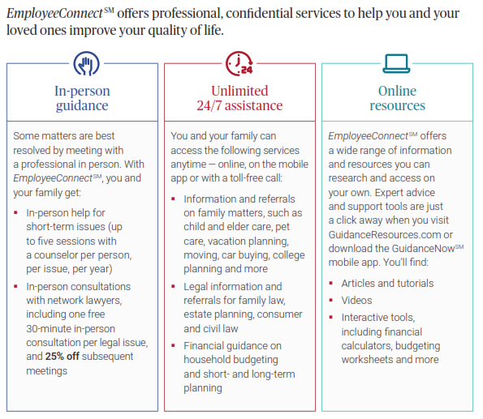
Employee Assistance Program
For Assistance Call
888-628-4824
Note: The benefit plan information shown in this guide is illustrative only. To the extent the benefit plan information summarized herein differs from the underlying plan details specified in the insurance documents that govern the terms and conditions of the plans of insurance described in this guide, the underlying insurance documents will govern in all cases.

Slide 12





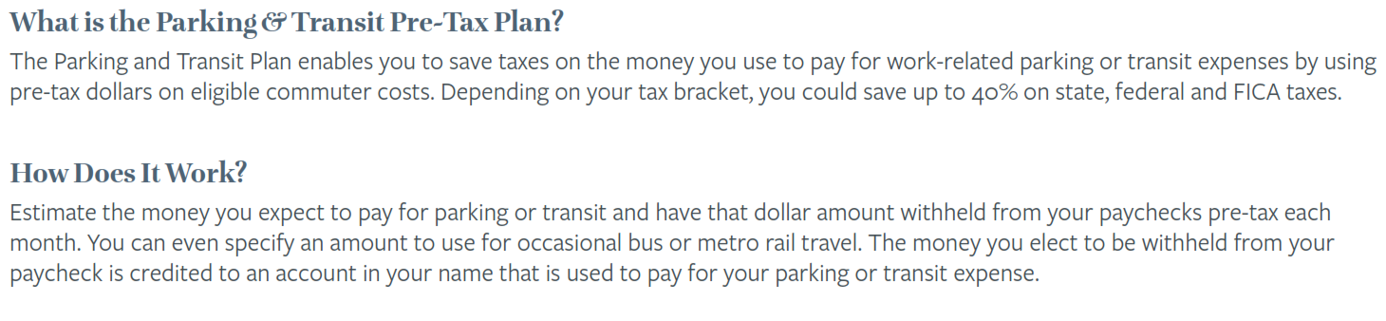
FSA and Commuter Benefit
Flexible Spending Account (FSA)
Health FSA Tax-free dollars to put towards eligible medical, dental, and vision expenses. | Dependent Care FSA Tax-free dollars for day care expenses for your qualified dependents (under 13 years old) while you work.
 | Health FSA | Dependent Care FSA
Administrator | P&A Group
2025 IRS Annual Max Contribution* | $3,300 | $5,000
Associated Medical Plan | Not Applicable (Employees are not required to enroll in one of the employer-offered medical plans.)
“Use It Or Lose It” | Yes | Yes
Pre-Tax Contribution Funding | Yes (Pre-taxability applies to all federal taxes)
Rollover | $660 | N/A
For assistance with your PA Group FSA please contact PA Group at 1-800-688-2611 or contact your Benefits Team!
Commuter Benefit
 | Parking | Transportation
2025 IRS Monthly Max Contribution | $315 | $315

Slide 13
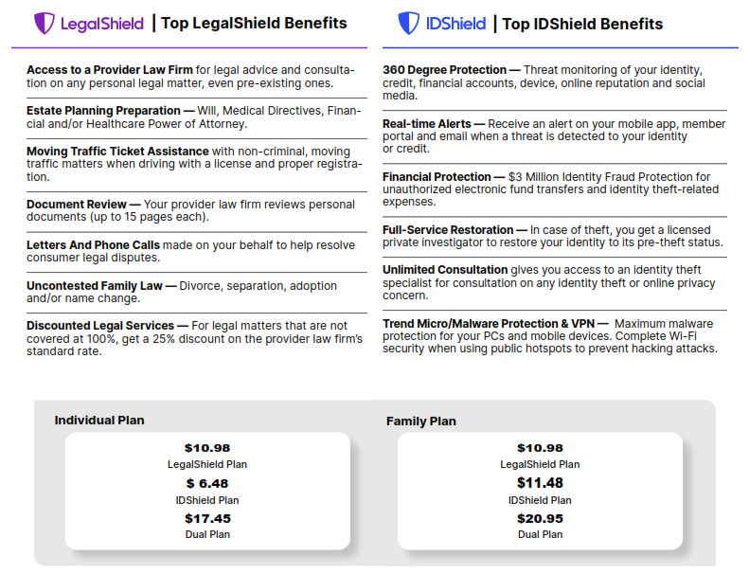
Legal Shield / ID Shield
Note: The benefit plan information shown in this guide is illustrative only. To the extent the benefit plan information summarized herein differs from the underlying plan details specified in the insurance documents that govern the terms and conditions of the plans of insurance described in this guide, the underlying insurance documents will govern in all cases.

Slide 14
CIISMRA’23
CIIS Medical Reimbursement Account
CIIS believes all employees should have health insurance. Employees who have health insurance elsewhere may elect not to enroll in CIIS health plans. CIIS does not reimburse individuals for declining coverage and requires proof of insurance with another insurer to decline CIIS coverage. A coverage declination form is required. Employees who decline coverage may be eligible to have funds deposited into a Medical Reimbursement Account as per the San Francisco Healthcare Security Ordinance. Some of the many health care expenses eligible for reimbursement are health insurance premiums, doctor’s office visits, dental services, vision services, and prescription and over-the-counter medicines. To see if you qualify for this coverage, please contact the Payroll & Benefits Manager for a review.
Note: The benefit plan information shown in this guide is illustrative only. To the extent the benefit plan information summarized herein differs from the underlying plan details specified in the insurance documents that govern the terms and conditions of the plans of insurance described in this guide, the underlying insurance documents will govern in all cases.

Slide 15
Paychex 401K
Retirement Planning
CIIS provides a 401(k) plan for eligible employees to assist in retirement planning. Current Employer contributions are at 2% of an employee's annual wages beginning after the first year of service (pro-rated for part-time employees). Our current Plan options include a choice of funds through John Hancock. Eligible employees include faculty and non-instructional staff, but exclude union employees, non-US resident staff, leased or temporary employees, adjunct faculty, and student workers. 401(k) Salary Deferrals, Roth Designated Contributions, Safe Harbor Contributions, and any rollover contributions are always 100% vested. The current vesting schedule applies only to Employer Discretionary Contributions. Only two loans are permitted at a time and hardship withdrawals are currently allowed. The Plan Retirement Age is 59 ½ years of age. To enroll follow these steps: 1. Log in to your Paychex Account and update your elections More information is available by contacting HR or Bob Driscoll at Miracle Mile Advisors (415) 345-8185
Note: The benefit plan information shown in this guide is illustrative only. To the extent the benefit plan information summarized herein differs from the underlying plan details specified in the insurance documents that govern the terms and conditions of the plans of insurance described in this guide, the underlying insurance documents will govern in all cases.

Slide 16


Education Assistance Program
Tuition Remission
Full Time Employees
Full-time employees who have completed 12 months of employment and are in good standing are eligible for Tuition Remission. This benefit also extends to qualified family members of those employees. For more information regarding this eligibility for this benefit, please contact Human Resources.
Part Time Employees
Part-time employees who have completed 24 months of employment and are in good standing, are also eligible for Tuition Remission. This benefit also extends to qualified family members of those employees. For more information regarding this eligibility for this benefit, please contact Human Resources.
Tuition Exchange
CIIS participates in Tuition Exchange (see www.tuitionexchange.org) and abides by the rules and regulations of the Tuition Exchange Association.
Note: The benefit plan information shown in this guide is illustrative only. To the extent the benefit plan information summarized herein differs from the underlying plan details specified in the insurance documents that govern the terms and conditions of the plans of insurance described in this guide, the underlying insurance documents will govern in all cases.

Slide 17

Fitness SF Gym Membership Discount Program
All Employees
All CIIS Employees are eligible for a discounted Gym Membership through Fitness SF With locations in Marin, Oakland, and several San Francisco sites, CIIS employees can receive discounts at Fitness SF. Currently, Fitness SF offers a $10 membership fee reduction per month. For more information, please see https://www.fitnesssf.com.
Note: The benefit plan information shown in this guide is illustrative only. To the extent the benefit plan information summarized herein differs from the underlying plan details specified in the insurance documents that govern the terms and conditions of the plans of insurance described in this guide, the underlying insurance documents will govern in all cases.

Slide 18






When Benefits Begin
NEW HIRE ELIGIBILITY BEGINS ON the FIRST OF THE MONTH Following/Coinciding with DATE OF HIRE | WHO CAN YOU ADD TO YOUR PLAN?
 | Eligible Dependents: Legally Married Spouse Natural | Adopted Children Disabled Child 19 Years Or Older Registered Domestic Partner | Ineligible Dependents: Divorced | Legally Separated Spouse Foster Children Siblings | Parents | Grandchildren
COMMON QUALIFYING LIFE EVENTS
Marriage | Birth | Adoption | Divorce
Gain | Loss Of Coverage | Death Of Spouse | Dependent | Receipt Of A Medical Support Order
26
There is a 30-day limitation from the time of the life event to declare your elections.
When Benefits End
TERMINATION RULES
Medical | Dental | Vision | Last Day of Month
Life | Disability | Last Day of Month
What options are available to me once my coverage is terminated?
Cobra will allow you to continue your current eligible benefits for up to 18 months.
Cobra becomes effective retroactively back to the day after your employment is terminated.
Note: The benefit plan information shown in this guide is illustrative only. To the extent the benefit plan information summarized herein differs from the underlying plan details specified in the insurance documents that govern the terms and conditions of the plans of insurance described in this guide, the underlying insurance documents will govern in all cases.

Slide 19
How to Find a Provider
Provider | How To
Medical | Kaiser Permanente | Go to: www.kp.org Network: Kaiser Select ‘Doctors & Locations’ (middle of page) Choose your region Search by doctor or location Enter your search parameter Select the doctor based off your needs
Medical | Roundstone Captive | Go to: www.cigna.com Click ‘Find a Doctor, Dentist or Facility’ on the top right of the page Enter your location Select the PPO, PPO Tiered Network option Search for provider or specialty
Dental | Guardian | Go to: www.guardiananytime.com Network: DentalGuard Preferred Select ‘Find a Provider’ from the top tabs on the page Click the green ‘Search Providers’ icon Select ‘Plan Type’: PPO Enter your ‘Zip or City and State’ Choose distance radius Enter ‘Dentist Last Name’ or ‘Office Name’ (Optional) Click ‘Search’ to browse for a dentist
Vision | VSP | Go to: www.vsp.com Network: Signature Select 'Find a Doctor' Search by the 'Location, Doctor or Office Name' Doctor Network is ‘Signature' Choose the doctor that works best for you on your plan
Note: The benefit plan information shown in this guide is illustrative only. To the extent the benefit plan information summarized herein differs from the underlying plan details specified in the insurance documents that govern the terms and conditions of the plans of insurance described in this guide, the underlying insurance documents will govern in all cases.

Slide 20
Alternatives to Group Insurance
Medicare Options Members age 65+
Medicare is a health insurance program for members 65 and older and people with certain disabilities. If you are eligible for Medicare or are becoming eligible in the next few months and would like to explore those options, please reach out to: Adam Lewis 916-529-8230 Adam.Lewis@ententetpa.com
Individual Options Individuals under 65 including Overage Dependents
If you have a child on your plan who is turning 26 this year and would like to explore options to cover them when they age off, please reach out to: Nathan Lewis 916-333-0631 Nathan.Lewis@ententetpa.com
Note: The benefit plan information shown in this guide is illustrative only. To the extent the benefit plan information summarized herein differs from the underlying plan details specified in the insurance documents that govern the terms and conditions of the plans of insurance described in this guide, the underlying insurance documents will govern in all cases.

Slide 21

Contacts
Carrier | Contact Info | Plan Number
Medical | Kaiser Permanente | Customer Service: (800) 464-4000 www.kp.org | 8804
Medical | Roundstone Captive | Customer Service: (800) 337-0792 | 22608
Dental | Guardian | Customer Service: (800) 541-7846 www. guardiananytime.com | 556153
Vision | VSP via Guardian | Customer Service: (844) 557-2646 www. guardiananytime.com | 556153
Life/AD&D | Disability Lincoln Financial Group | Customer Service: (877) 275-5462 www. lfg.com | 01-0181550
LFG – EAP | Contact Guidance Resources: 888-628-4824
Your HR Team
Luis Mellado lmellado@ciis.edu | Lesa Hammond lhammond@ciis.edu
Your Benefits Team
ADAM LEWIS Account Manager (916) 529.8230 Adam's Schedule adam.lewis@ententetpa.com | NATHAN LEWIS VP Client Services (916) 333.0631 Schedule a Phone call nathan.lewis@ententetpa.com
Note: The benefit plan information shown in this guide is illustrative only. To the extent the benefit plan information summarized herein differs from the underlying plan details specified in the insurance documents that govern the terms and conditions of the plans of insurance described in this guide, the underlying insurance documents will govern in all cases.

Slide 22
Payroll Deductions 24 Pay Periods

Slide 23
Payroll Deductions 26 Pay Periods

